Slide 1
Enhancing Matrix Reports
Notes:
Schedule: Timing Topic
<xx> minutes Lecture
<xx> minutes Practice
<xx> minutes Total

Slide 2
Objectives
After completing this lesson, you should be able to do the following:
  Design a matrix Data Model
  Design a matrix Paper Layout
  Modify a matrix structure
  Create and modify matrix summaries
  Create a matrix with group report
  Create a nested matrix report
Notes:
Lesson Aim
<Enter lesson aim here.>

Slide 3
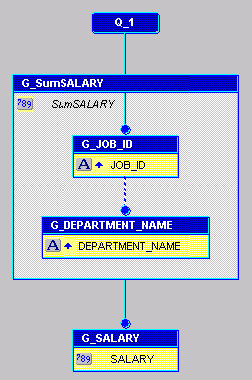
The Matrix Data Model
1
4
2
3

Slide 4
The Matrix Paper Layout
Job Title
F_job_id
Dept Name
Sumsalary
F_department_na
F_Sumsalary
1
2
3

Slide 5
Creating Matrix Summaries
F_CITY
2
Job Title
F_job_id
Dept Name
Sumsalary
F_name
F_Sumsalary
F_SumsalaryPerDEPT
1
F_SumsalaryPerJOB_I
F_SumsalaryPerCITY
F_SumsalaryPer
3

Slide 6
Creating the Matrix Manually
  Using the Data Wizard:
    Select the Matrix query check box
    Step through the wizard
  Entirely manual:
    Select the appropriate query tool
    Create extra groups
    Create the cross product group

Slide 7
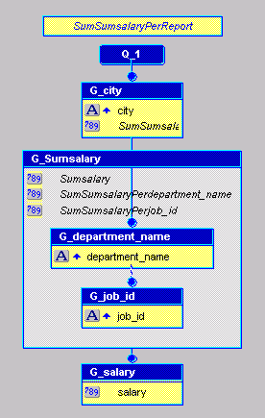
The Matrix with Group Data Model
1
4
5
2
3

Slide 8
The Matrix with Group Layout
Total:
Region:
F_CITY
Job Title
F_job_id
Dept Name
Sumsalary
F_department
F_Sumsalary
F_SumsalaryPerDEPA
F_SumsalaryPerTITLE
F_SumsalaryPerCITY
Total:
F_SumsalaryPer

Slide 9

Building a Nested Matrix

Slide 10
Building a Nested Matrix

Slide 11
Building a Nested Matrix

Slide 12
Nested Matrix Layout

Slide 13
Creating Matrix Summaries
F_SumSALARY
F_SumSALPerDEPA
F_Sum_CITY
F_SumSALPerJOB_

Slide 14
Understanding Product Order hidden slide for instructors
Job_ID
City
Department
CDJ
CD
D
CJ
C
J
Notes:
Understanding Product Order (nested matrix summaries) - addition teaching aid
To help students understand the Product Order setting and the effect on the position of summaries in the layout, you might want to list the possible combinations on the whiteboard and draw the diagram above to position each combination.
Given the same repeating frames as before: R_Region, R_Dept, R_Title, where departments are nested within each region, the possible combinations are:
G_Region G_Dept G_Title RDT
G_Region G_Dept RD
G_Region G_Title R T
G_Dept G_Title DT
G_Region R
G_Dept D
G_Title T
Add each into the diagram in the applicable position. The product order defines the calculation; it also defines the position in the layout, if you use the reentrant Report wizard to create the layout.

Slide 15
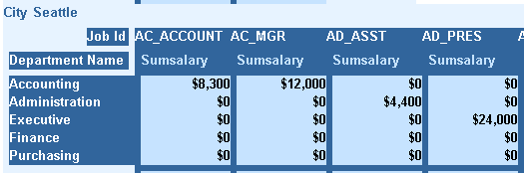
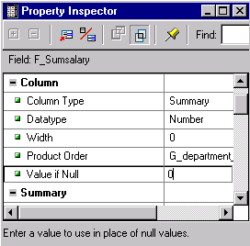
Displaying Zeros

Slide 16
Summary
  In this lesson, you should have learned how to:
  Create matrix reports with the Report Wizard
  Describe the relationship between the data and layout in a cross product structure
  Identify and describe matrix-specific elements:
    Cross product group
    Product Order property
    Matrix layout object

Slide 17
Practice 18 Overview
  Opening and changing an existing matrix report
  Building a nested matrix report
  Adding summaries to a nested matrix report
  Displaying zeros for summary values and restricting columns per page
  Displaying more meaningful column information and rotating the text

